Slide 1
Steganography, its types and tools
Aqib Hussain and Sidrat-ul-Muntha

Slide 2
Agenda
Introduction
Types
Tools
Practical Demo of Tools

Slide 3
What is steganography?
It comes from the Greek words steganos, which means “covered” or “hidden,” and graph, which means “to write”.
Technique of hiding secret data within an ordinary file or message in order to avoid detection.
One can use steganography to hide text, video, images, or even audio data.

Slide 4
Different Types of Steganography
Depending on the nature of the cover object(actual object in which secret data is embedded), steganography can be divided into five types:
Text Steganography
Image Steganography
Audio Steganography
Video Steganography
Network or Protocol Steganography

Slide 5
Text Steganography
Text steganography is a mechanism of hiding secret text message inside another text as a covering message or generating a cover message related with the original secret message.

Slide 6
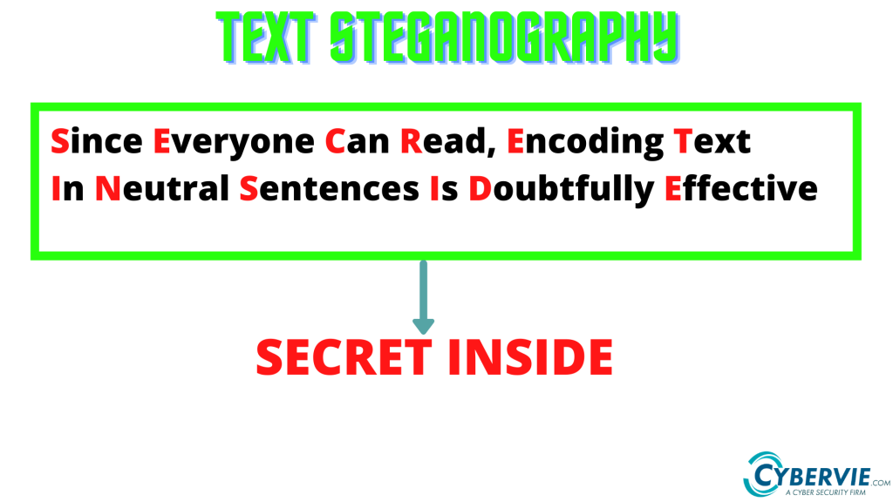

Slide 7
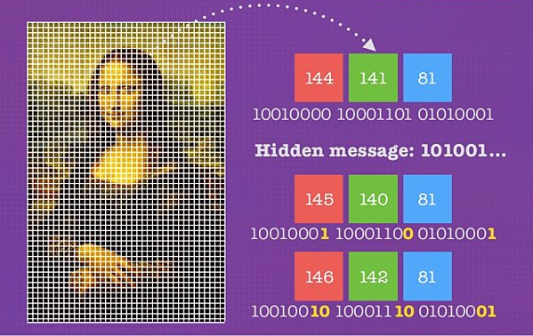
Image Steganography
Image steganography is concealing data by using an image of a different object as a cover. Pixel intensities are the key to data concealment in image steganography.

Slide 8
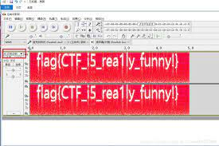
Audio Steganography
It is the science of hiding data in sound. Used digitally, it protects against unauthorized use.

Slide 9
Video Steganography
Video steganography is a method of secretly embedding data or other files within a video file on a computer. Video (a collection of still images) can function as the "carrier" in this scheme.
Discrete cosine transform (DCT) is commonly used to insert values that can be used to hide the data in each image in the video, which is undetectable to the naked eye.

Slide 10
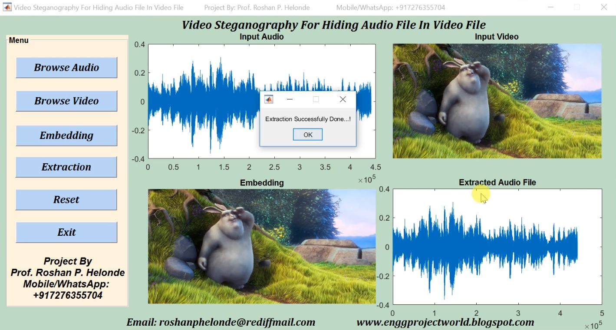

Slide 11
Network or Protocol Steganography
It involves concealing data by using a network protocol like TCP, UDP, ICMP, IP, etc., as a cover object.
Steganography can be used in the case of covert channels, which occur in the OSI layer network model.

Slide 12
Steganography Tools
Steghide: Steghide is a free tool that uses steganography to conceal information in other files, such as media or text.
Stegosuite: It is a Java-based, free steganography tool. Stegosuite makes it simple to obfuscate data in pictures for covert purposes.
OpenPuff: It is a high-quality steganographic tool that allows you to conceal data in other media types like images, videos, and Flash animations.
Xiao Steganography: To conceal information in BMP images or WAV files, use the free Xiao Steganography tool.
SSuite Picsel: The free portable program SSuite Picsel is yet another option for hiding text within an image file; however, it uses a somewhat different method than other programs.

Slide 13
Audacity
Audacity is a free, easy-to-use, multi-track audio editor and recorder for Windows, macOS, GNU/Linux and other operating systems.
You can also use Audacity as a Audio Analysis Tool.

Slide 14
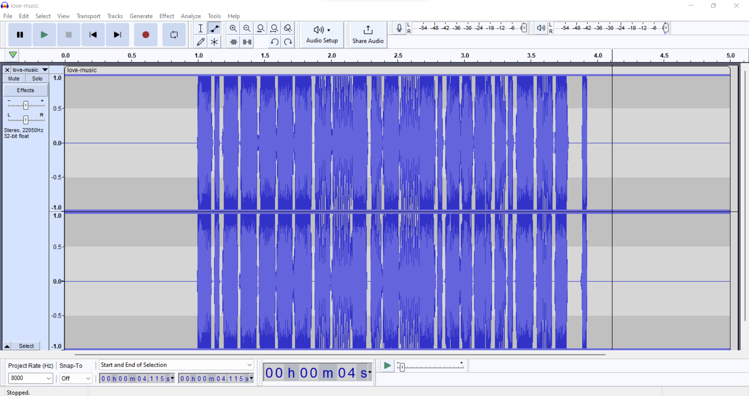

Slide 15
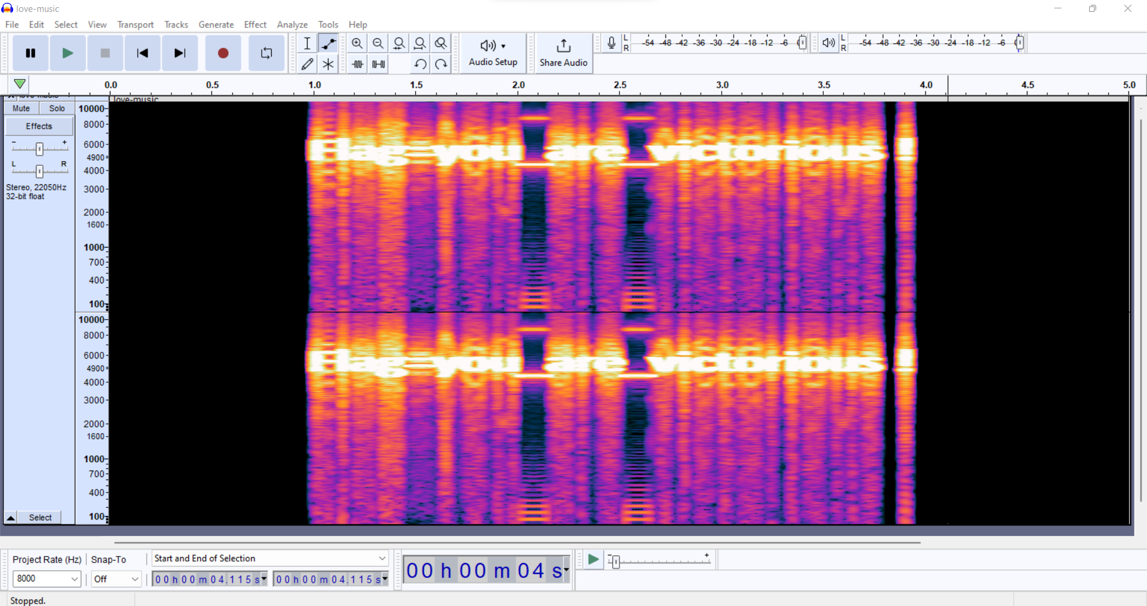

Slide 16
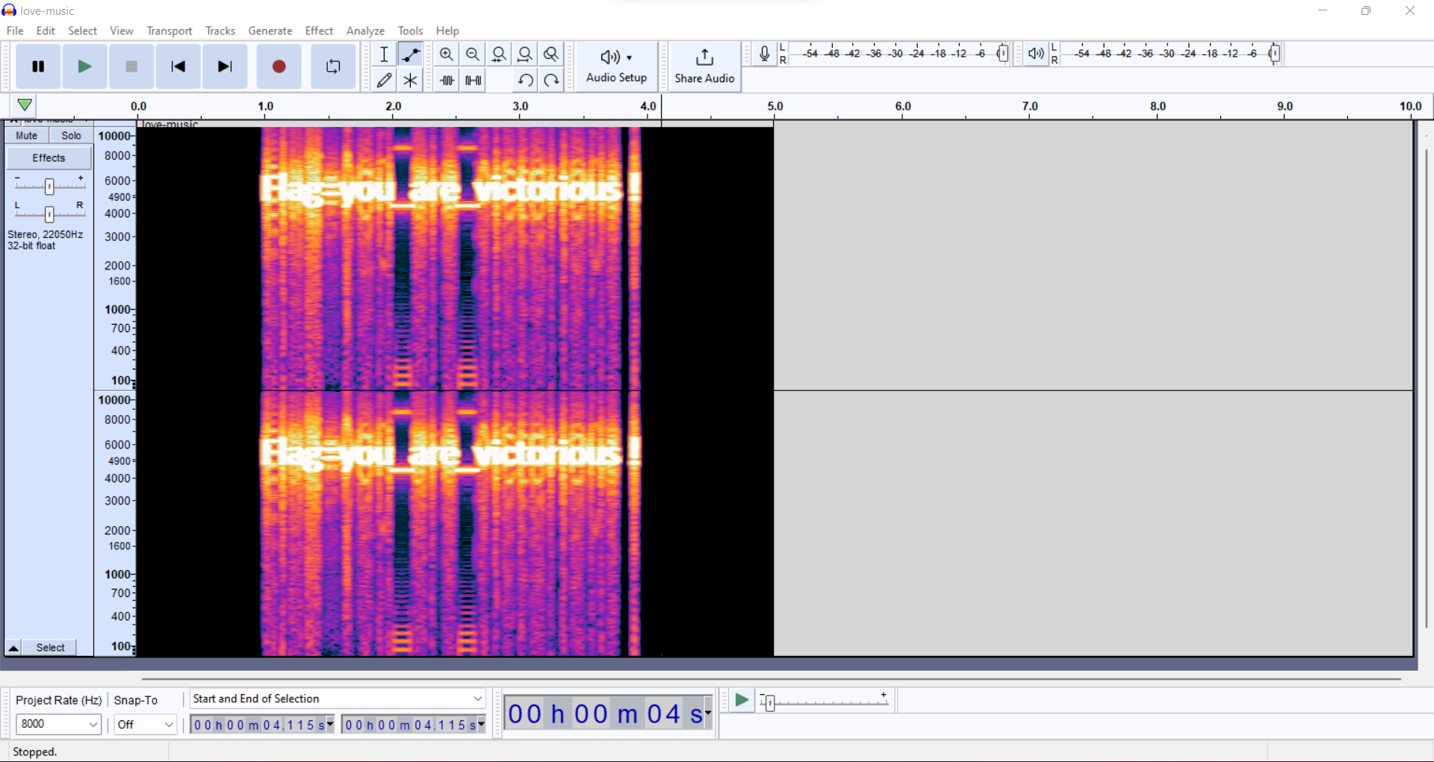

Slide 17
Steganography Online Website
Used for Image Steganography.
https://stylesuxx.github.io/steganography/

Slide 18
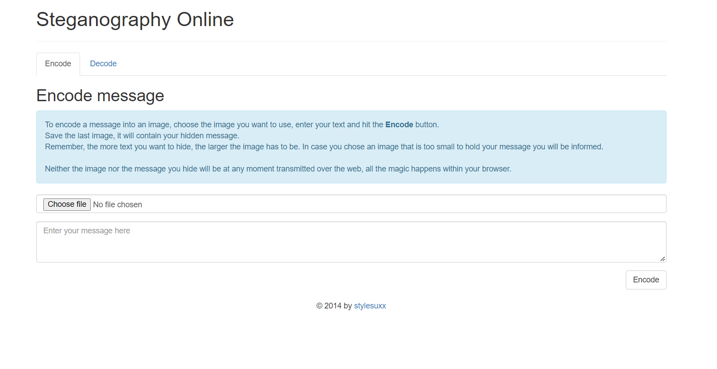

Slide 19
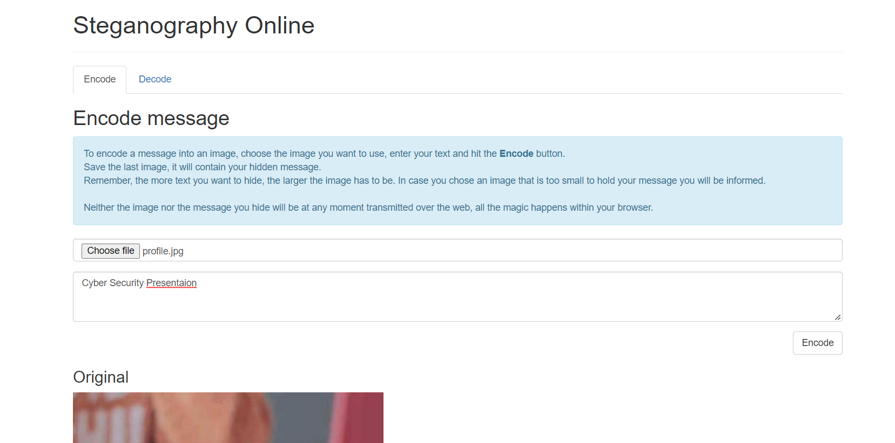

Slide 20
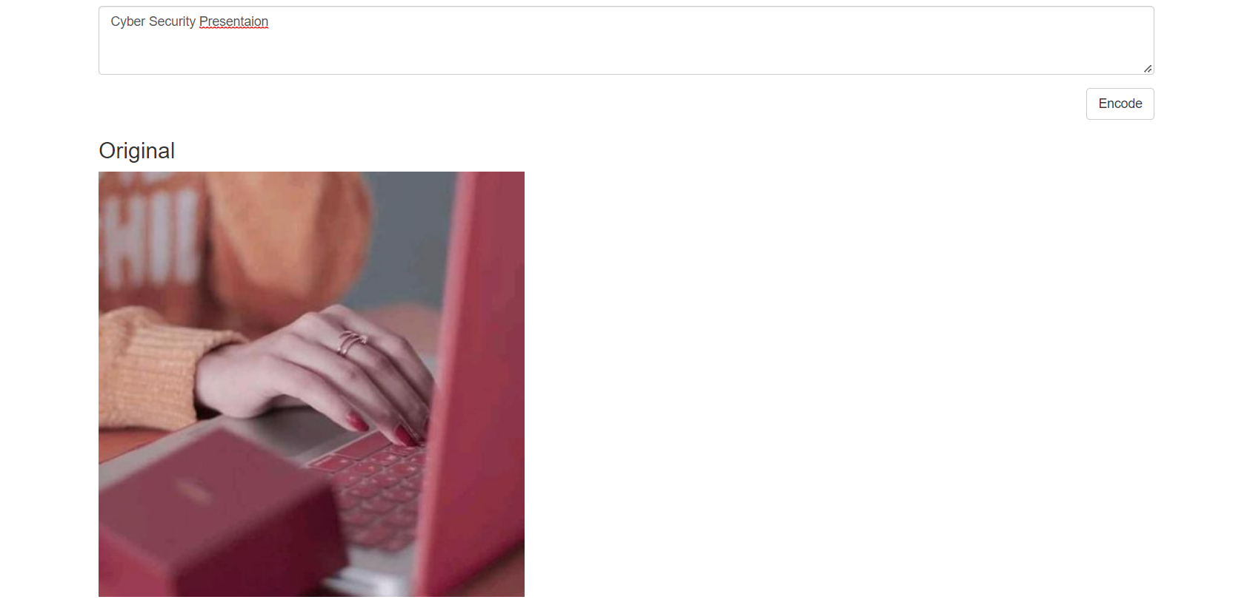

Slide 21
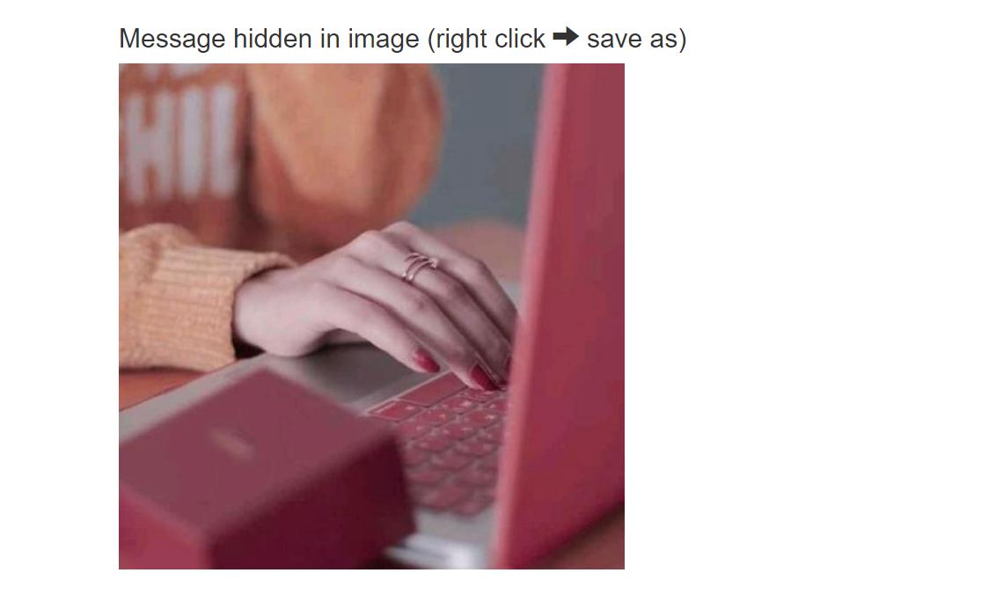

Slide 22
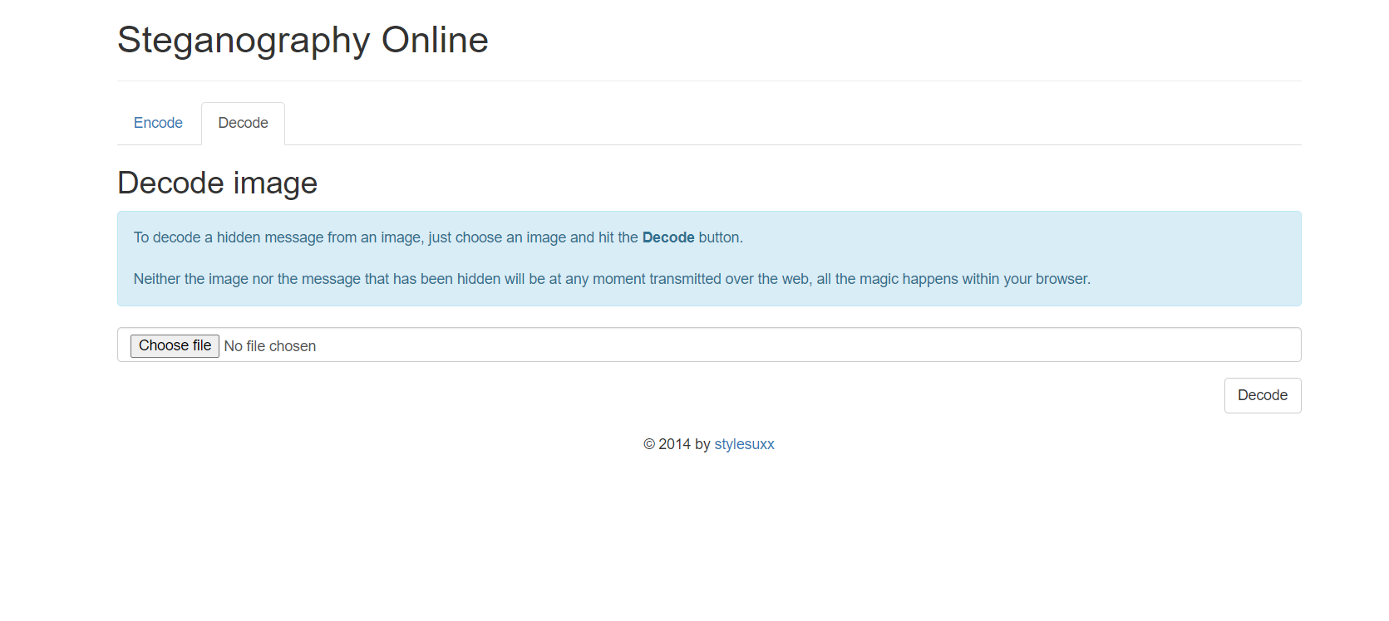

Slide 23
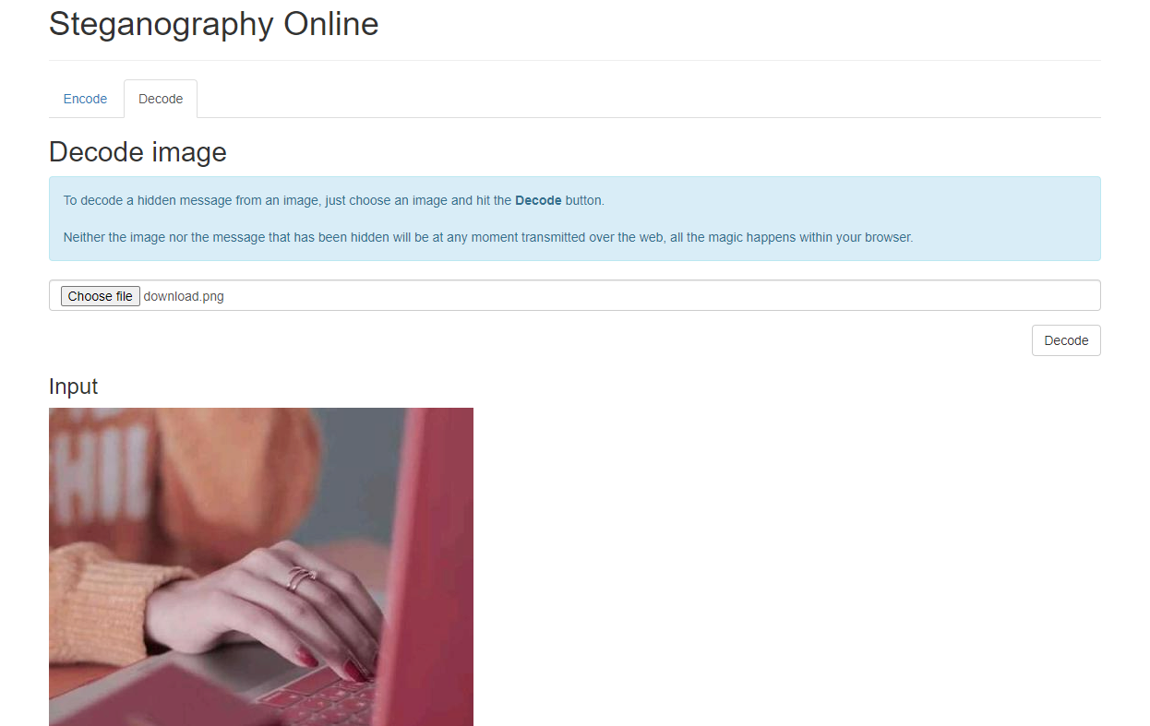

Slide 24
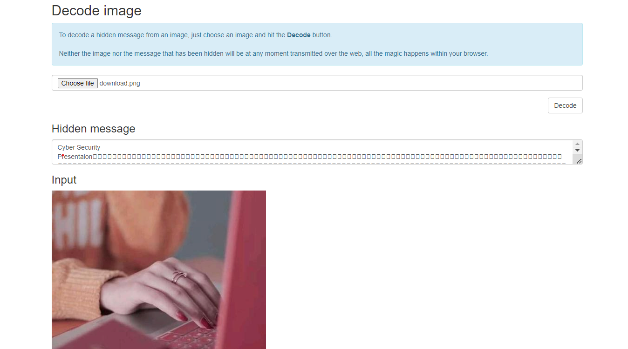

Slide 25



